Slide 1


AI VS Human Translation: The Inevitable Replacement?
Dr Sai-cheong SIU
Director, Deep Learning Research and Application Centre
Associate Professor, School of Translation
The Hang Seng University of Hong Kong

Slide 2
Artificial Intelligence
New Translation Algorithms
New Translation Applications
AI and People
Impact of AI on Translation and Communication
What does translation technology mean for your business?
What are the roles of AI and human translators in multilingual communication?

Slide 3
Outline
Overview: Translation Industry and Translation Technology
Types of Translation Technology: Automatic Translation and More
AI for Translation: Strengths, Weaknesses and the Way Forward

Slide 4
About Us

Slide 5
Private University
5 Schools
(Business, Communication, Decision Sciences, Humanities and Social Science, and Translation)
The Hang Seng University of Hong Kong
Undergraduate and Postgraduate Programmes

Slide 6
School of Translation
Bachelor of Translation with Business
Master of Arts in Translation (Business and Legal)
Master of Arts in Translation (Computer-aided Translation)
Minor in European Studies

Slide 7
Deep Learning Research and Application Centre

Slide 8
Artificial Intelligence
Machine Learning
Symbolic AI
Deep Learning
Many others (e.g., SVM, Decision tree, k-NN)

Slide 9
Deep Learning
Deep Learning technology, which is based on neural networks and large training datasets, has shown great success in many applications.

Slide 10
Deep Learning
AlphaGo
Speech
recognition
Sentiment analysis
Summarization
Chatbot
Stock price prediction
Image classification
Object detection
Self-driving cars and many more

Slide 11
Deep Learning Research and Application Centre
Funding of HK$6.8 million
Hardware: Graphics processing unit (GPU)-accelerated hardware for much faster training and decoding
Software: PyTorch, Tensorflow, Keras, Transformer…
Projects involving deep neural networks

Slide 12
Projects (https://dlc.hsu.edu.hk/)
Machine translation (e.g., automatic translation of listing documents; recent funding: HK$1.4 million)
Smart retail
English proofreading
Weather analysis, forecast and communication
Detection of fake news
Financial analysis

Slide 13
Overview: Translation Industry and Translation Technology

Slide 14
What do translators mean for your business? What does a translator do?
Translation
Interpreting
Localization
Bilingual Editing and Writing
Many more
(e.g., transcription, certification, term management…)

Slide 15
Turnaround Time
Translation
Volume
Text types
Language Services
Translation
Linguistic and Cultural Issues
Project Management
Technical Knowledge

Slide 16
It’s more than Gxxxle Translate
Translation Technology
Electronic tools for Translation

Slide 17
Types of Translation Technology

Slide 18
Translation Technology
Electronic Dictionaries
Translation Memories
Terminology Databases
Automatic Translation

Slide 19
Electronic Dictionaries
General Dictionaries
Specialised Dictionaries

Slide 20
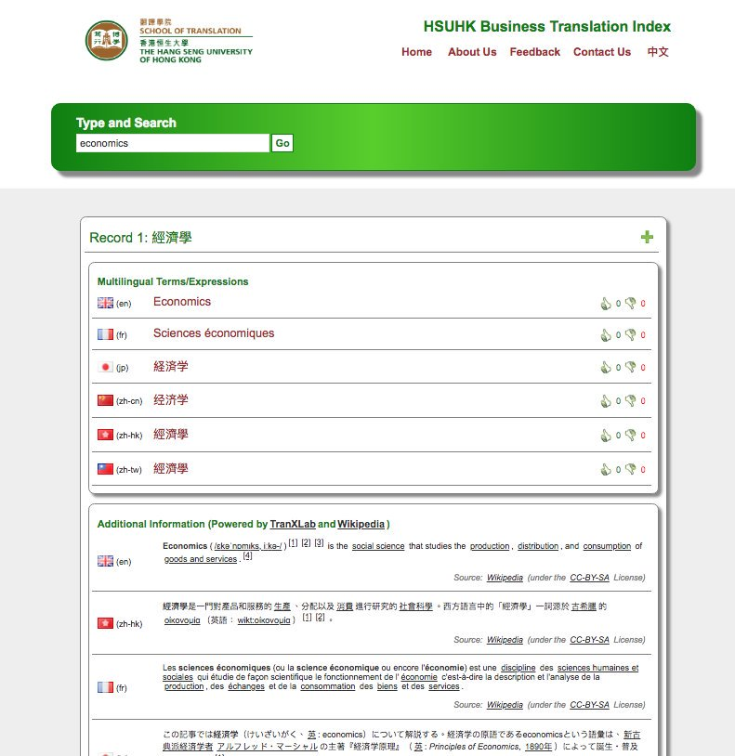
Example: HSUHK Business Translation Index
http://www.hsuhkbti.com/

Slide 21
Translation Memory (TM)
ST = Sentence in English
TT = Sentence in French
ST
ST
Translation Memory
ST
ST
ST
TT
TT
TT
TT
TT

Slide 22
Translation Memory (TM)
New Sentence in English
Similar Sentence in English
Corresponding translation in French
New ST
ST
TT
Translation Memory
Corresponding translation in French
New TT
New Sentence in French
TT

Slide 23
What does TM mean for your business?
Translation
Speed
Translation
Cost
Translation
Style
Translation
Flexibility

Slide 24
Terminology Database (Termbase)
ST | TT | Definition
Term 1 | Term 1 | XXXXX
Term 2 | Term 2 | XXXXX
Term 3 | Term 3 | XXXXX
Terminology Database

Slide 25
Terminology Database (Termbase)
New ST
ST | TT | Definition
Term 1 | Term 1 | XXXXX
Term 2 | Term 2 | XXXXX
Term 3 | Term 3 | XXXXX
-----------------------------------------------------------------
Terminology Database
Automatic Translation
Detailed information

Slide 26
What do Termbases mean for your business?
Accuracy
Consistency

Slide 27
Machine Translation (MT)
Automatic Translation System
ST
TT
?

Slide 28
Methods
Rule-based Approach
Example-based Approach
Statistical Approach
Deep Learning Approach

Slide 29
Biological Neuron
dendrite
axon terminal
soma
2
activation
“input”
from
other
neurons
axon
“output” to
other
neurons
1
3
nucleus

Slide 30
Artificial Neuron
Input
1
Example: Adding (input value x weight)
Example: If the sum of the input > 0, the output = 1.
weight = 0.5
Output
0
weight = 0.2
Activation Function
1
Sum
(~soma)
(~axon)
weight = 0.3
Ans: 0.8
1
(~dendrites)

Slide 31
Artificial Neural Network: Many Neurons

Slide 32
Deep Learning: Multiple Hidden Layers
Input
Hidden
Output

Slide 33
Neural Machine Translation (NMT)
3
0
6
2
4
7
0
0
3
0
6
2
4
7
7
0
ST
TT

Slide 34
Image Translation
ST
(text)
ST
(an image)
Optical Character Recognition
Machine Translation
TT

Slide 35
Speech Translation
ST
(text)
TT
(text)
ST
(speech)
Speech Recognition
Machine Translation
Speech Synthesis/
Text-to-speech (TTS) Engine
TT (speech)
ST
(speech)
TT (speech)

Slide 36
Other Tools
Corpora and Concordancers
Localization Tools
Translation Servers
Checkers
Tool for summarization
Computer-aided Editing Tools

Slide 37
AI for Translation: Strengths, Weaknesses and the Way Forward

Slide 38
Strengths
Speed
Gist Translation
Translation Draft
Translation of Repetitive Elements
Term Consistency
Language Learning

Slide 39
Weaknesses
Accuracy
Ambiguity
Limited Context
Cultural Issues
Limited Text Types
Lack of Reasoning

Slide 40
The Way Forward
Collaboration
Modes
Tools
Skills
Identifying ways of collaboration for different translation activities

Slide 41






 | Levels of User-Computer Interaction
Human Translation | Machine-aided/assisted Human Translation (MAHT) | Human-aided/assisted Machine Translation (HAMT) | Machine Translation (MT)

Slide 42
The Way Forward
Collaboration
Modes
Tools
Skills
Designing tools for different types of translation: Facilitating human-human interaction and human-computer interaction

Slide 43
Tools
Language Professionals
Translation Researchers
General Public
General Translation
Domain-specific Translation
Other Language Services

Slide 44
Integrated Tools for Translation of Financial Documents
Significance of financial translation: IPO documents as an example
Largest IPO Centre:
US$36.5 billion in 2018
Integral Part of Initial Public Offerings
Bilingual Prospectuses
IPO documents are usually prepared by lawyers and accountants in English and need to be translated to Chinese as required by HKEX. The translation task, usually handled by printing companies, is costly and labor-intensive.

Slide 45
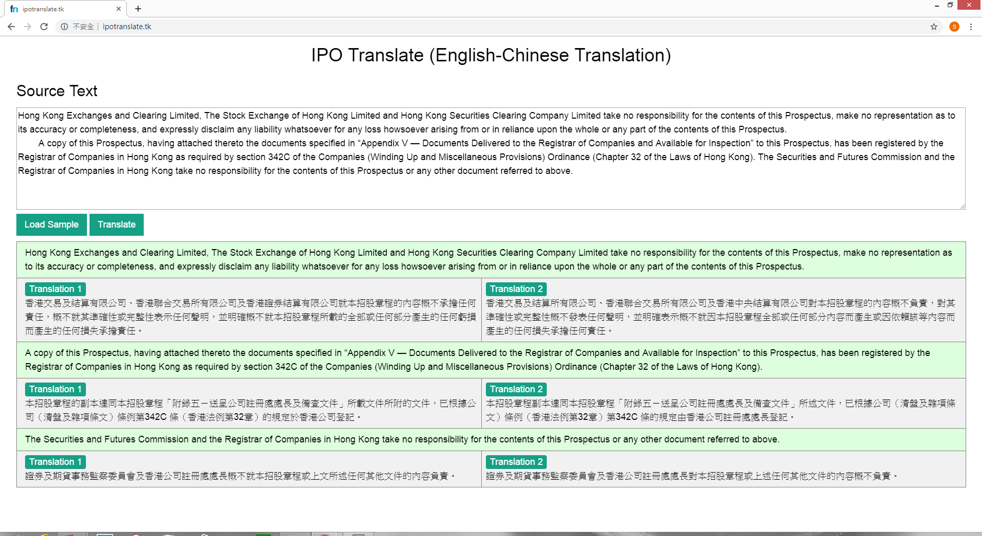
Tool 1: IPO Translate

Slide 46
Tool 2: FinTranX
Feature 1
Deep Learning Technology
Feature 2 Domain-specific Machine Translation
Feature 3
Tool Integration for Interaction
Automatic Translation: Generation of translation draft
Translation Memory: Reuse of previous translations
Terminology Databases: Translation of terms
External Databases: Online research

Slide 47
The Way Forward
Collaboration
Modes
Tools
Skills
Developing skills for better collaboration in the era of AI-aided Translation

Slide 48
Language Skills Reading, Writing, Listening and Speaking
Translation Skills Translation Methods and Translation Theories
Evaluation
Editing
Project Management
Tool Operation and Customization
Database Management
AI and Machine Learning

Slide 49
AI VS Human Translation: Inevitable Replacement?
Collaboration
Language professionals familiar with AI
Language professionals NOT familiar with AI

Slide 50
Thank you very much!
Email: scsiu@hsu.edu.hk

Slide 52
Additional Information

Slide 53
Research on Financial Translation

Slide 54
2014: Hang Seng Management College Business Translation Index
2015: “Automated Pre-editing and post-editing: A Hybrid Approach to the Computerized Translation of IPO Prospectuses”, Journal of Translation Technology 1(1)
2016: Neural Machine Translation
2017: Establishment of Deep Learning Centre
2018: Project Supported by the Innovation and Technology Fund
2019: Development of an Integrated Platform for Translation of IPO Documents

Slide 55
Example: HSUHK Business Translation Index
http://www.hsuhkbti.com/SearchBTI?search=technical+analysis

Slide 56
MT Methods

Slide 57
Traditional Approaches to Machine Translation
01
I go to school by train.
我／去／學校／乘／火車／。
我乘火車去學校。
Rule-based Machine Translation
02
I go to school by train.
I go to school by taxi. 我乘計程車去學校。
我乘火車去學校。
Example-based Machine Translation
03
Translation Model
P(“I”|“我”) x P(“go”|“去”) x ...
Language Model:
P(“我乘火車去學校”)
Statistical Machine Translation

Slide 58
Word Embedding

Slide 59
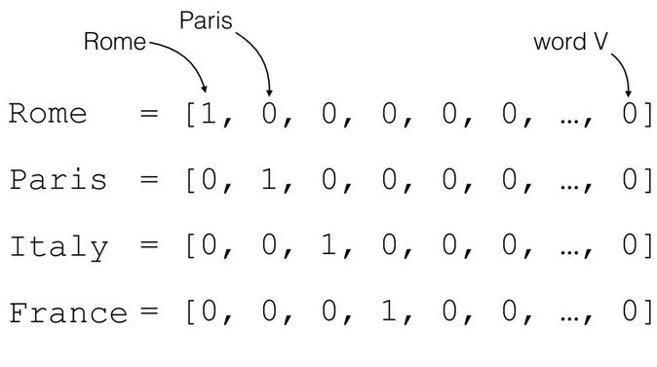
Word Embedding (1): One-hot Vector
For more information, visit
https://medium.com/@athif.shaffy/one-hot-encoding-of-text-b69124bef0a7

Slide 60
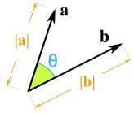
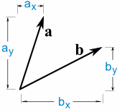
Problem
a · b = a_{x} × b_{x} + a_{y} × b_{y} = |a||b|cos(θ)
For more information, visit
https://www.mathsisfun.com/algebra/vectors-dot-product.html

Slide 61
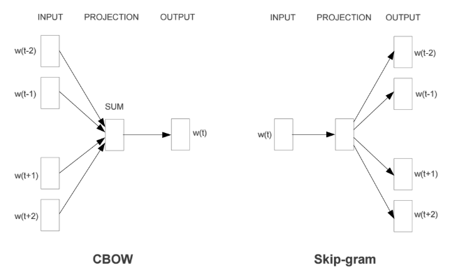
Word Embedding (2): Continuous Bag of Words and Skip-gram
For more information, visit
https://mubaris.com/2017/12/14/word2vec/

Slide 62
NMT

Slide 63
Methods
Rule-based Approach
Example-based Approach
Statistical Approach
Deep Learning Approach

Slide 64
Biological Neuron
dendrite
樹突
axon terminal
軸突末端／終末
soma
細胞體
2
activation
“input”
from
other
neurons
axon 軸突
“output” to
other
neurons
1
3
nucleus
細胞核

Slide 65
Biological Neural Network
…
…

Slide 66
Artificial Neuron
Input
1
Example: Adding (input value x weight)
Example: If the sum of the input > 0, the output = 1.
weight = 0.5
Output
0
weight = 0.2
Activation Function
1
Sum
(~soma)
(~axon)
weight = 0.3
Ans: 0.8
1
(~dendrites)

Slide 67
Artificial Neural Network: Many Neurons

Slide 68
Deep Learning: Multiple Hidden Layers
Input
Hidden
Output

Slide 69
Artificial Neural Network
1
1
0
0
1
1
1
0
0
1
0
1
A number
A list of numbers
Another list of numbers
(more “meaningful”)
1

Slide 70
Artificial Neural Network and Image Processing
Probability
that the picture
is a …
0
1
0
1
0
1
1
0
0.55
0.300.10
0.05
cat
tiger
dog
man
Multi-class Classification

Slide 71
Automatic Translation as a Prediction Problem: Given X, what is the next word?
Given the following:
ST: I / go / to / school / by / bus / . /
TT: 我 / 乘
Which of the following is most likely to be the next word?
公車
火車
學校
咖啡
電腦
翻譯

Slide 72
Deep Learning and Automatic Translation
Given [I] / [go] / [to] / [school] / [by] / [train] / [.], what is the next word?
我
[I] / [go] / [to] / [school] / [by] / [train] / [.] / [我] ⇒ ?
乘
[I] / [go] / [to] / [school] / [by] / [train] / [.] / [我] / [乘] ⇒ ?
火車
[I] / [go] / [to] / [school] / [by] / [train] / [.] / [我] / [乘] / [火車] ⇒ ?
去
[I] / [go] / [to] / [school] / [by] / [train] / [.] / [我] / [乘] / [火車] / [去] ⇒ ?
學校
[I] / [go] / [to] / [school] / [by] / [train] / [.] / [我] / [乘] / [火車] / [去] / [學校] / ⇒ ?
。
Translation: 我乘火車去學校。

Slide 73
Neural Machine Translation as Multi-class Classification
Probability
Of the next Chinese word
0
1
0
1
0
1
1
0
1
0
0
1
0
1
0
1
0
1
0
1
0
0.02
0.95
0.03
0
0
0
0
0
0
0
0
0
0
0
你
我
他
乘
走
跑
公車
計程車
火車
去
來
學校
公司
公園
Probability
that the picture
is a …
0
1
0
1
0
1
1
0
ST: I go to school by bus.
0.55
0.300.10
0.05
cat
tiger
dog
man

Slide 74
Neural Machine Translation
Probability
of the next Chinese word
0
0
1
0
1
0
0
0
1
0
0
1
0
1
0
1
0
1
0
1
0
0
1
0
1
0
1
1
0
1
0
0
1
0
1
0
1
0
1
0
1
0
0
1
0
0
0
0
0
0
0
0
0
0
0
0
0
0
0
0.96
0.03
0.01
0
0
0
0
0
0
0
0
你
我
他
乘
走
跑
公車
計程車
火車
去
來
學校
公司
公園
你
我
他
乘
走
跑
公車
計程車
火車
去
來
學校
公司
公園
0
1
0
1
0
1
1
0
ST: I go to school by bus.
TT:
我

Slide 75
Neural Machine Translation
Probability
of the next Chinese word
0
1
1
0
0
1
0
0
1
0
0
1
1
0
1
0
1
1
0
1
0
0
0
1
0
1
0
0
0
1
0
0
1
0
1
0
1
0
1
0
1
0
0
0
0
0.96
0.03
0.01
0
0
0
0
0
0
0
0
0
0
0
0
0
0
0.80
0.10
0.10
0
0
0
0
0
你
我
他
乘
走
跑
公車
計程車
火車
去
來
學校
公司
公園
你
我
他
乘
走
跑
公車
計程車
火車
去
來
學校
公司
公園
ST: I go to school by bus.
TT:
我乘

Slide 76
Neural Machine Translation
Probability
of the next Chinese word
0
1
1
1
1
1
1
1
1
1
0
1
0
1
1
0
0
1
1
1
0
0
0
1
0
1
0
0
0
1
0
0
1
0
1
0
1
0
1
0
1
0
0
0
0
0
0
0
0.80
0.10
0.10
0
0
0
0
0
0
0
0
0
0
0
0
0
0
0.75
0.25
0
0
0
你
我
他
乘
走
跑
公車
計程車
火車
去
來
學校
公司
公園
你
我
他
乘
走
跑
公車
計程車
火車
去
來
學校
公司
公園
ST: I go to school by bus.
TT:
我乘公車

Slide 77
Neural Machine Translation
Probability
of the next Chinese word
0
0
0
0
1
1
0
0
0
1
1
0
1
0
1
1
0
1
0
0
0
0
1
1
1
1
1
1
1
1
1
0
1
0
1
1
0
0
1
1
1
0
0
0
0
0
0
0
0
0
0
0.75
0.25
0
0
0
0
0
0
0
0
0
0
0
0
0
0
0.90
0.08
0.02
你
我
他
乘
走
跑
公車
計程車
火車
去
來
學校
公司
公園
你
我
他
乘
走
跑
公車
計程車
火車
去
來
學校
公司
公園
ST: I go to school by bus.
TT:
我乘公車去

Slide 78
Bidirectional LSTM

Slide 79
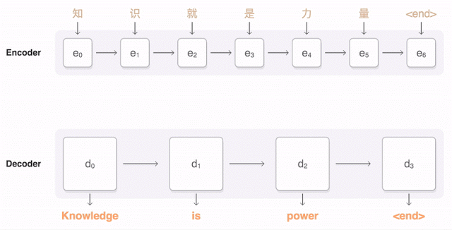
RNN Encoder-decoder with Attention
For more information, visit
https://ai.googleblog.com/2016/09/a-neural-network-for-machine.html

Slide 80
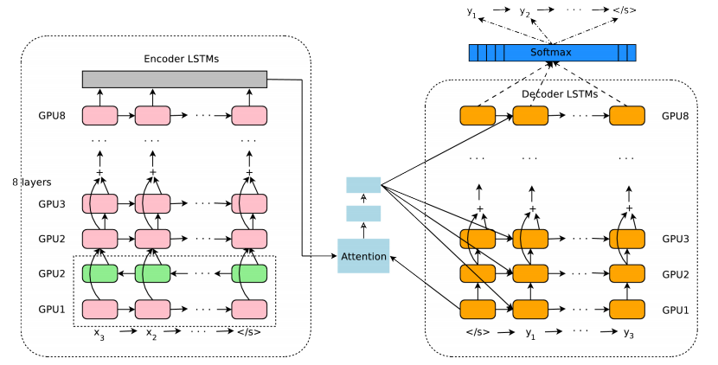
RNN Encoder-decoder with Attention
For more information, visit
https://arxiv.org/pdf/1609.08144.pdf

Slide 81
Self-attentional Transformer

Slide 82

Self-attentional Transformer
For more information, visit
https://ai.googleblog.com/2017/08/transformer-novel-neural-network.html

Slide 83
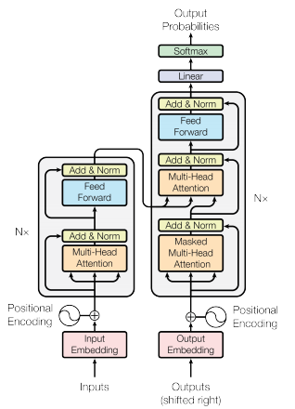
Self-attentional Transformer
For more information, visit
https://arxiv.org/pdf/1706.03762.pdf

Slide 84
Evaluation

Slide 85
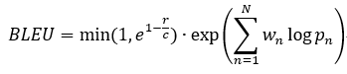
Automatic Evaluation
The use of Bilingual Evaluation Understudy (BLEU) metric (Papineni, Roukos, Ward, & Zhu, 2002), a measure of n-gram precision with a value between 0 and 1, comparing a machine translation output with a reference:

